Slide 1
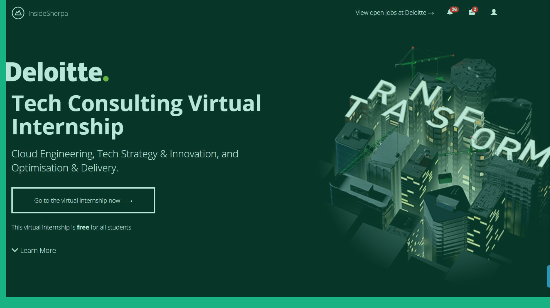

Slide 2
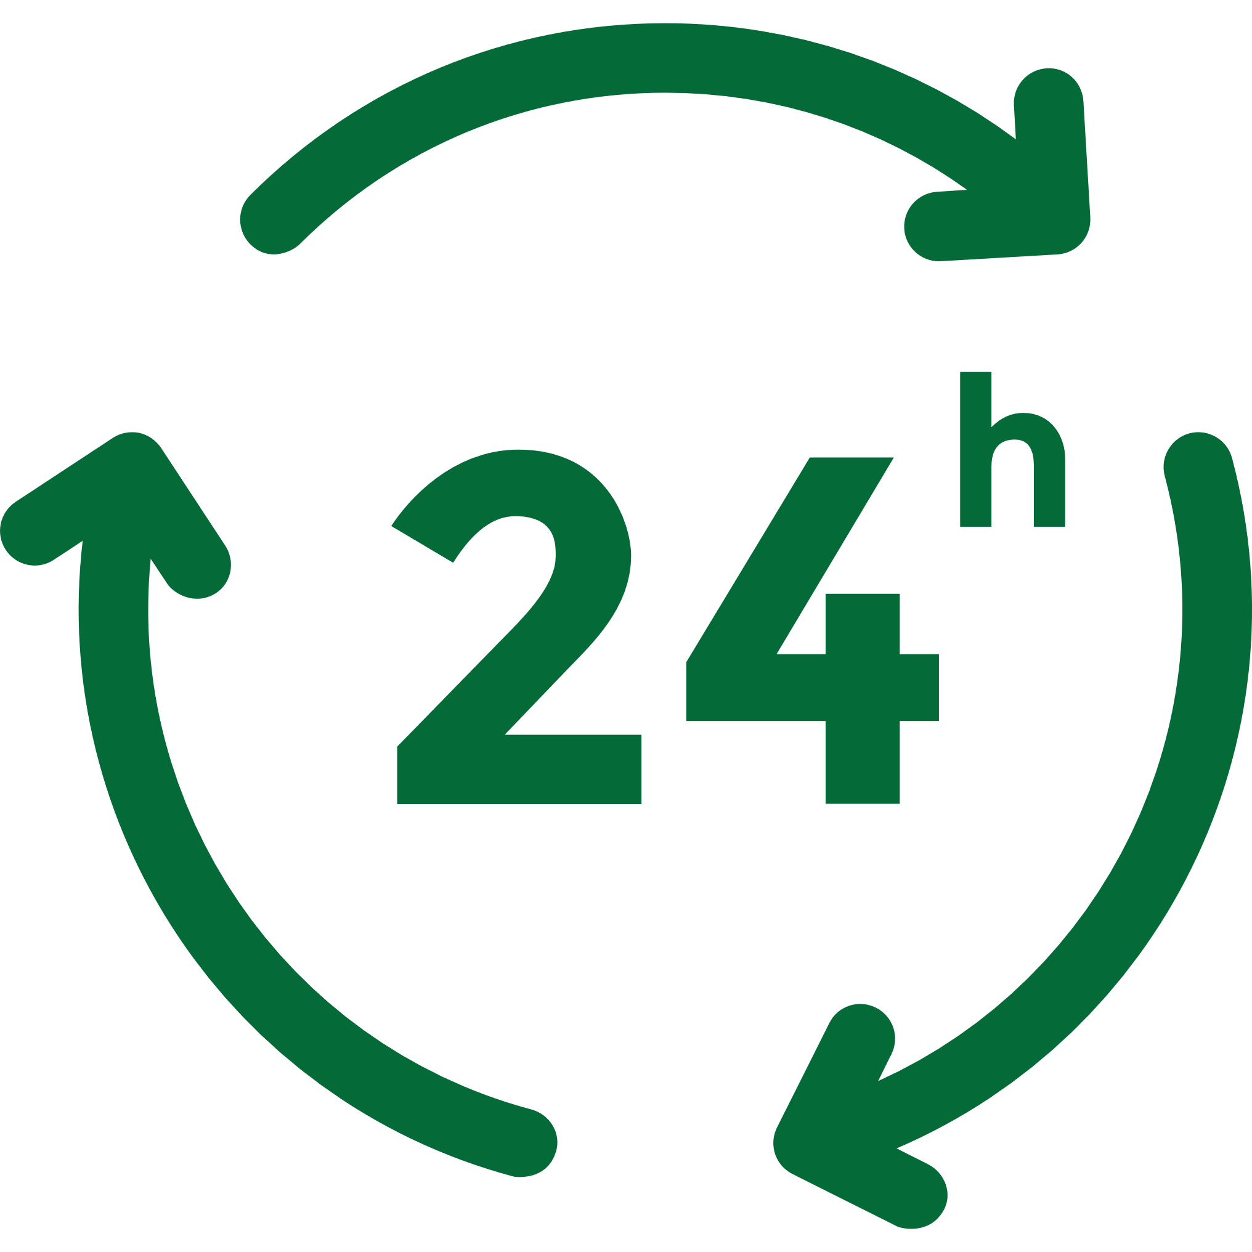




Cloud Feasibility Assessment
Task 2
Benefits
Scalability
High Availability
Automation
Flexibility
Security Controls
Notes:
1. Scalability- As mentioned, the existing IT infrastructure has some systems reach peak during enrolment. Other face a downtime in peak periods. These could be the systems for Academic record creation and class tests. In peak hours they go past their capacity.
2. High Availability- Infrastructure will be highly available in the Cloud with fewer outages experienced and less downtime. Applications will exist across a number of disparate Cloud Data Centres and can auto recover or terminate and restart if performance drops enabling continued quality of services.
3. Automation and Ease of Management- A lot of the processes can be automated and easily managed. The service limits, access to external SaaS applications, all can be managed.
4. Flexibility- The University will have access to the full range of programming models, operating systems, databases and architecture with which they are familiar as well as new services available through the marketplace. The University will not be locked into infrastructure purchases and will have more freedom of choice
5. Greater Security Controls- Cloud environments keep track of all changes made through logging and can make use of the latest firewalls and security features to reduce the likelihood and impact of cyber-attacks and internal mistakes.

Slide 3
Risks & Considerations
Task 2
Risks
Skill
The IT Team is not equipped with the skills to manage the transition to the Cloud Platform.
Capability
Unable to develop new capability quickly in line with platform migration
Manual Work Increase
Early migration activities may initially delay current IT processes and increase manual workloads.
Security Breach
Security policies may not be enforced leading to data compromise.
Risk Averse Culture
The IT team is averse to the change from the current ways of working.
Changes to Cloud Costs
Risk that costs of Cloud services will increase, straining the IT Budget.
Considerations
Establish Cloud Function and training program to teach them about the operation.
Develop standards and build patterns to be used for application deployments in the Cloud.
Optimize Cloud environments for automation by developing decision criteria that is independent of human intervention.
Define and run regular security audits and penetration testing to ensure Cloud security is maintained across the network.
Run sessions with Senior Leadership and have managers lead the change. Run a town hall with all IT staff.
Negotiate price-protection with Cloud providers during procurement process and optimize the environment against cost.

